Slide 1
Itility Machine Learning Hackathon
Predicting hub demand
1.0 by DKOO LGEE
March 11, 2019

Slide 2

The Case: Amber
Car-sharing company
All electric BMW i3’s
Founded in Eindhoven by three TU/e students in 2017
Focus on business market
About ±30 employees
USP: guaranteed availability
± 45 hubs nationwide
±130 cars

Slide 3
The Case: Amber
USP: guaranteed availability
Planners make an estimate per hub, per shift
Students drive around to redistribute cars between low-, and high-demand hubs
We are helping Amber with a demand prediction model
It runs every 6 hours, predicting demand per hub, per shift, for the shift 12 hours later
The model is live but it’s not good enough (yet)

Slide 4
The Goal
Based on the following data, make an estimate for the demand per hub, per shift, for the following week (28-feb to 6-march)
Historic demand
Hub ID
Standing reservations (at least 12hours upfront)*
Weather conditions
(School) holidays
We already did some feature engineering
E.g. checkouts 12 hours*, 24 hours ago*, 7 days ago, etc.
* Data leaks in test set

Slide 5
About data leaks…
In theory you could use ‘checkouts_12h’ to fill-in the test set and get a good RMSE
On the other hand we do not want to keep information from you that we can use in our model (such as standing reservations)
Though if we would only let you predict one shift, it would be hard to confirm if you model turned out better
We run the model every six ours, however we ask you to predict whole week upfront, which will almost always be worse
We will send the test set 30 minutes before the end
Please do not incorporate this data leak in your model! You might win but obviously your work will be of no use in practice!

Slide 6
The Data
A CSV file containing:
id
year
month
day (Sunday = 0)
day_part (6h shift, 0 = 0-6 hours, etc.)
start_hub_id
weekday
week
checkouts
reservations
checkout_min12h
checkout_min24h
checkout_min1w
checkout_min2w
checkout_min3w
checkout_min4w
temp
rain
is_holiday (only national holidays)
holidays_in_week
zuid_school (school vacations)
midden_school
noord_school

Slide 7
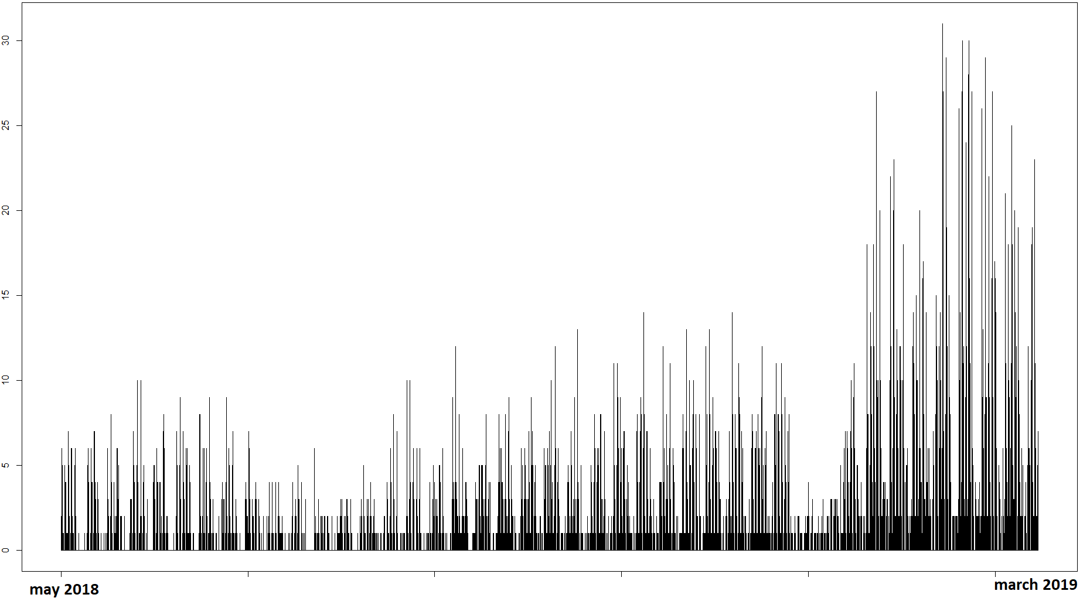
Challenges
They grow pretty fast, making historic data quickly become less relevant

Slide 8
Our current approach
This is our current model approach:
Boosted decision tree (XGBoost) model
Objective function: count poisson
Eval metric: RMSE
Max.depth: 5
Rounds: 200
Eta / step: 0.3
Min. child weight: 2
Subsample: 0.80
Colsample by tree: 0.75
Max. step delta: 3

Slide 9
On our to-do list, for some inspiration
Feature engineer a reservation / checkout ratio
Transform data to account for non-linear growth (normalize, z-value, log prediction, assign weights to older / newer data etc.)
Add business-rules for cases the model lacks now (e.g. predicting less than standing reservations, but then again reservations do get cancelled..)
Try other models
Try ensembles with other models
And of course add more datasources, but that’s out of scope for this hackathon..
.. unless you know of some public available dataset we can easily add, you’re welcome to do so ☺

Slide 10
The solutions
Mail solutions to daniel.koops@itility.nl
Please mind the following before sending:
Only 2 columns needed in solutions csv file:
id
checkouts
Submit all predictions
Submit integers, if not they will be rounded to the nearest
Use a semicolon (;) as separator and the exact headers (makes my life easier ☺).
Id; checkouts
50997; 1
50998; 1
50999; 1
51000; 1
51001; 1
51002; 1
... ...

Slide 11
The pitch
Prepare a short presentation (max. 5mins) explaining:
Your approach
Some advice for us on making the model better
The team with the lowest RMSE wins (I will round to integers first)
Bonus points for the best pitch and advice (Marianne’s applause meter)

Slide 12
Benchmarks
Current model performance:
~1,5 RMSE
Predict all 1’s
2,25 RMSE

Slide 13
The data

